Slide 1

SOKOINE UNIVERSITY OF AGRICULTURE
School of Engineering and Technology | Department of Agricultural Engineering
AEN 214: INTRODUCTION TO ELECTRONICS — LECTURE 6
Field Effect Transistor (FET)
JFETs, MOSFETs, Gate Charge Dynamics, Power MOSFETs & Solar Irrigation Pump Inverters
Course Instructor: Dr. Kadeghe Goodluck Fue, PhD, P.Eng (T)
Electronics & Precision Agriculture Laboratory | Academic Year 2025/2026 | Sokoine University of Agriculture
Sokoine University of Agriculture | School of Engineering & Technology | Department of Agricultural Engineering
Slide 1 of 26

Slide 2
AEN 214: INTRODUCTION TO ELECTRONICS
Lecture 6 Learning Outcomes & Practical Scope
• Contrast Unipolar vs Bipolar Physics: Voltage-controlled FET operation vs current-controlled BJT mechanics.
• Analyze JFET Principles: Understand pinch-off voltage V_P, saturation current I_DSS, and Shockley's equation.
• Evaluate Transconductance g_m: Derive g_m = dI_D / dV_GS and determine operating point transconductance.
• Analyze JFET Biasing Networks: Design Self-Bias and Voltage Divider Bias configurations.
• Differentiate MOSFET Topologies: Depletion-Enhancement (DE-MOSFET) vs Enhancement-Only (E-MOSFET) devices.
• Master Power MOSFET Dynamics: Gate charge Q_G, threshold voltage V_GS(th), ON-resistance R_DS(on), and heat sinking.
• Deploy Power MOSFETs in AgriTech: Design solar brushless DC pump inverters and implement ESD protection protocols.
Sokoine University of Agriculture | School of Engineering & Technology | Department of Agricultural Engineering
Slide 2 of 26

Slide 3
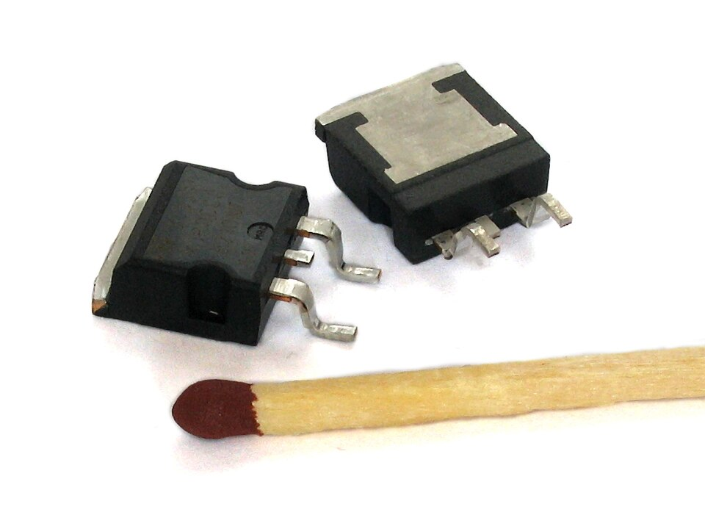
AEN 214: INTRODUCTION TO ELECTRONICS
Field Effect Transistors in Modern Agro-Mechatronics
• The Powerhouse of Solar Irrigation: High-efficiency solar water pumping systems rely exclusively on Power MOSFETs.
• Negligible Gate Drive Power: Ultra-high input impedance (> 10^12 Ohm) allows microcontrollers to control kilowatts of motor power.
• High-Speed PWM Actuation: Power MOSFETs switch at 20 kHz to 100 kHz with minimal switching losses in variable-rate sprayers.
• Superior Thermal Stability: MOSFETs have a positive temperature coefficient of ON-resistance (R_DS(on)), preventing thermal runaway.
• Harsh Agro-Climatic Vulnerability: Insulated silicon dioxide (SiO2) gate dielectric is microscopically thin; easily punctured by static electricity.
Sokoine University of Agriculture | School of Engineering & Technology | Department of Agricultural Engineering
Slide 3 of 26

Slide 4
AEN 214: INTRODUCTION TO ELECTRONICS
Fundamental Comparison: FET versus BJT
• Control Mechanism: BJT is current-controlled (I_C controlled by I_B); FET is voltage-controlled (I_D controlled by gate voltage V_GS).
• Carrier Type: BJT is bipolar (conduction involves both electrons and holes); FET is unipolar (conduction involves only majority carriers).
• Input Impedance: BJT input impedance is moderate (1 kOhm to 10 kOhm); FET input impedance is astronomical (10^9 to 10^14 Ohm).
• Thermal Coefficient: BJT has negative tempco (prone to thermal runaway); Power MOSFET has positive tempco (inherently self-stabilizing).
• Switching Speed: FETs have zero minority carrier storage time; switch orders of magnitude faster than power BJTs.
• Noise Performance: FETs exhibit substantially lower thermal and flicker noise; ideal for high-impedance agricultural sensor preamps.
Sokoine University of Agriculture | School of Engineering & Technology | Department of Agricultural Engineering
Slide 4 of 26

Slide 5
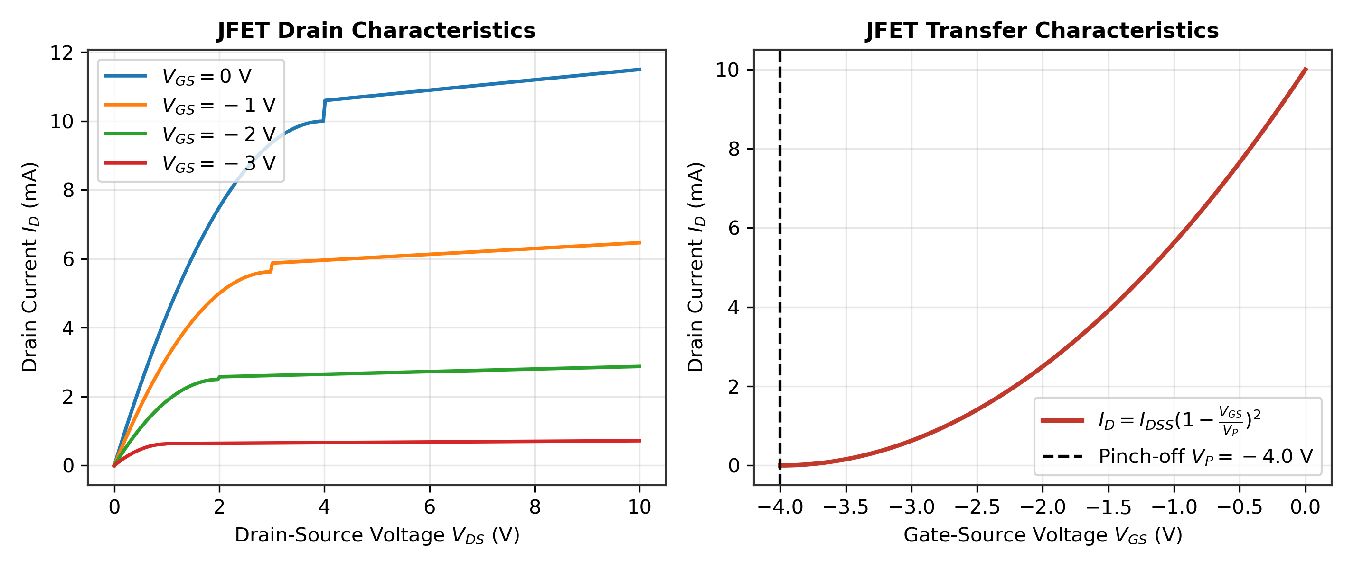
AEN 214: INTRODUCTION TO ELECTRONICS
Junction Field Effect Transistor (JFET) Physics
• N-Channel JFET Construction: Bar of N-type silicon with Drain (D) and Source (S) ohmic contacts at opposite ends.
• Gate Electrodes: Two heavily doped P⁺ regions embedded on opposite sides of the channel, connected together as the Gate (G).
• Normally-ON Depletion Device: With V_GS = 0 V and small V_DS, majority electrons flow freely from source to drain through the open channel.
• Reverse-Biased Gate Junction: Applying negative gate voltage (V_GS < 0) widens the P⁺N depletion regions into the channel, constricting channel width.
• Voltage-Controlled Resistor (Ohmic Region): At low V_DS, the channel behaves as a linear resistor whose resistance is modulated by V_GS.
Sokoine University of Agriculture | School of Engineering & Technology | Department of Agricultural Engineering
Slide 5 of 26

Slide 6
AEN 214: INTRODUCTION TO ELECTRONICS
Pinch-off Voltage V_P & Shockley's Transfer Equation
• Pinch-Off Phenomenon: As drain voltage V_DS increases, the drain-end depletion layers expand until they touch (pinch off) at V_DS = |V_P|.
• Saturation (Active) Region: Beyond pinch-off (V_DS >= V_GS - V_P), current saturates to a constant level governed strictly by gate voltage V_GS.
• Pinch-Off Voltage (V_P): Gate-to-source cutoff voltage that pinches channel completely shut at V_DS = 0 (typically -2V to -8V for N-channel).
• Drain Saturation Current (I_DSS): Maximum drain current flowing when V_GS = 0 V and V_DS >= |V_P|.
• Shockley's Transfer Equation: In saturation region: I_D = I_DSS · [ 1 - (V_GS / V_P) ]².
• Square-Law Characteristic: Drain current varies quadratically with gate voltage; provides pure second-harmonic transfer without higher distortions.
Sokoine University of Agriculture | School of Engineering & Technology | Department of Agricultural Engineering
Slide 6 of 26

Slide 7
AEN 214: INTRODUCTION TO ELECTRONICS
JFET Small-Signal Transconductance g_m
• Definition of Transconductance: The rate of change of drain current with respect to gate-source voltage: g_m = dI_D / dV_GS |_(Q-point).
• Mathematical Derivation: Differentiating Shockley's equation: dI_D / dV_GS = 2 · I_DSS · [ 1 - (V_GS / V_P) ] · (-1 / V_P).
• Operating Transconductance Formula: g_m = g_m0 · [ 1 - (V_GS / V_P) ], where maximum transconductance g_m0 = (2 · I_DSS) / |V_P|.
• Transconductance in Terms of Drain Current: g_m = g_m0 · sqrt( I_D / I_DSS ); Transconductance is proportional to square root of drain current.
• Units: Measured in Siemens (S), milliSiemens (mS), or micro-mhos (typically 1.0 mS to 10.0 mS for small-signal JFETs).
Sokoine University of Agriculture | School of Engineering & Technology | Department of Agricultural Engineering
Slide 7 of 26

Slide 8
AEN 214: INTRODUCTION TO ELECTRONICS
JFET Self-Bias Circuit Architecture
• Single-Supply Biasing: JFET requires negative V_GS, but Self-Bias generates this negative potential using a single positive supply V_DD.
• Source Resistor Mechanism: Source current I_D flows through resistor R_S, establishing a positive source voltage: V_S = I_D · R_S.
• Gate Resistor Grounding: Large gate resistor R_G (1 MOhm to 10 MOhm) ties gate to ground: Since gate current I_G ≈ 0, V_G = 0 V.
• Resulting Negative Bias: V_GS = V_G - V_S = 0 - I_D · R_S = - I_D · R_S.
• Self-Regulating Action: If I_D attempts to rise -> V_S rises -> V_GS becomes more negative -> constricts channel -> forces I_D back down!
• Source Resistor Sizing: R_S = |V_GSQ| / I_DQ; Sized from desired Q-point coordinates.
Sokoine University of Agriculture | School of Engineering & Technology | Department of Agricultural Engineering
Slide 8 of 26

Slide 9
AEN 214: INTRODUCTION TO ELECTRONICS
Worked Engineering Example 1: JFET Self-Bias Q-Point for Soil pH Probe Pre-Amp
PROBLEM SPECIFICATION & AGRICULTURAL CONTEXT:
A 2N5458 N-channel JFET buffers a high-impedance soil pH glass electrode sensor in a Morogoro agricultural chemistry lab. Manufacturer datasheet specifications: I_DSS = 8.0 mA and V_P = -4.0 V. The circuit uses self-bias with V_DD = 18.0 V, drain resistor R_D = 2.2 kOhm, and source resistor R_S = 560 Ohm. Gate resistor R_G = 2.2 MOhm. Determine: (a) Quiescent drain current I_DQ, (b) Quiescent gate-source voltage V_GSQ, (c) Quiescent drain-source voltage V_DSQ, (d) Transconductance g_m at Q-point.
STEP-BY-STEP MATHEMATICAL SOLUTION & VERIFICATION:
1. Formulate System of Equations: Equation 1 (Shockley): I_D = I_DSS · [ 1 - (V_GS / V_P) ]²; Equation 2 (Bias Line): V_GS = - I_D · R_S.
2. Substitute V_GS into Shockley: I_D = 8.0 mA · [ 1 - (- I_D · 560 / -4.0) ]² = 0.008 · [ 1 - 140 · I_D ]².
3. Expand Quadratic: I_D = 0.008 · [ 1 - 280 · I_D + 19,600 · I_D² ] = 0.008 - 2.24 · I_D + 156.8 · I_D².
Standard Quadratic: 156.8 · I_D² - 3.24 · I_D + 0.008 = 0.
Using quadratic formula: I_DQ = [ 3.24 - sqrt(3.24² - 4 · 156.8 · 0.008) ] / (2 · 156.8) = [ 3.24 - 2.341 ] / 313.6 = 0.002867 A = 2.87 mA.
4. Calculate Voltages: V_GSQ = - I_DQ · R_S = - (2.87 mA · 560 Ohm) = - 1.607 V.
V_DSQ = V_DD - I_DQ · (R_D + R_S) = 18.0 V - 2.87 mA · (2,200 + 560) = 18.0 V - 7.92 V = 10.08 V.
5. Calculate Operating Transconductance: g_m0 = (2 · I_DSS) / |V_P| = (2 · 8.0 mA) / 4.0 V = 4.0 mS.
g_m = g_m0 · [ 1 - (V_GSQ / V_P) ] = 4.0 mS · [ 1 - (-1.607 / -4.0) ] = 4.0 · (1 - 0.4018) = 2.39 mS.
Sokoine University of Agriculture | School of Engineering & Technology | Department of Agricultural Engineering
Slide 9 of 26

Slide 10
AEN 214: INTRODUCTION TO ELECTRONICS
MOSFET Architecture: Insulated Gate Field Effect Physics
• Insulated Gate Structure: Metal gate electrode is electrically isolated from the semiconductor channel by an ultra-thin Silicon Dioxide (SiO2) layer.
• Zero Gate Current: Gate oxide dielectric resistance exceeds 10^14 Ohm; DC gate leakage current is measured in pico-Amperes (pA).
• Depletion-Enhancement MOSFET (DE-MOSFET): Built with a physical silicon channel; can operate in either depletion mode (V_GS < 0) or enhancement mode (V_GS > 0).
• Enhancement-Only MOSFET (E-MOSFET): No physical channel exists at zero bias; completely normally-OFF (I_D = 0 at V_GS = 0).
• Channel Inversion: Applying positive V_GS repels holes and attracts minority electrons to the surface, creating an inverted N-type conductive layer.
• Threshold Voltage (V_GS(th)): Minimum positive gate voltage required to form the conductive inversion channel (typically 1.5V to 4.0V).
Sokoine University of Agriculture | School of Engineering & Technology | Department of Agricultural Engineering
Slide 10 of 26

Slide 11
AEN 214: INTRODUCTION TO ELECTRONICS
Enhancement MOSFET Governing Equations
• Cutoff Region (V_GS < V_GS(th)): Inversion channel is not formed; drain current I_D = 0; switch is fully OPEN.
• Ohmic (Triode / Linear) Region (V_GS > V_GS(th) and V_DS < V_GS - V_GS(th)): Channel conducts as a continuous resistor.
• Ohmic Current Equation: I_D = k · [ 2 · (V_GS - V_GS(th)) · V_DS - V_DS² ], where k is device transconductance parameter (A/V²).
• Saturation (Active) Region (V_DS >= V_GS - V_GS(th)): Drain-end channel pinches off; current saturates into constant current source.
• Saturation Current Equation: I_D = k · [ V_GS - V_GS(th) ]².
• Device Constant k: k = 0.5 · mu_n · C_ox · (W / L), where C_ox is gate capacitance per unit area, and W/L is channel width-to-length ratio.
Sokoine University of Agriculture | School of Engineering & Technology | Department of Agricultural Engineering
Slide 11 of 26

Slide 12
AEN 214: INTRODUCTION TO ELECTRONICS
Power MOSFETs: Vertical Trench Architecture
• Planar vs Vertical Conduction: Small-signal FETs conduct horizontally across the chip surface; Power MOSFETs conduct vertically from top to bottom.
• Vertical DMOS / Trench HEXFET: Current flows vertically from source on the top surface down through epitaxial drift layer to drain on the bottom tab.
• Massive Paralleled Cells: Millions of microscopic hexagonal cells integrated in parallel on a single silicon die to achieve massive current ratings (50A to 200A+).
• Ultra-Low ON-Resistance (R_DS(on)): State-of-the-art power MOSFETs achieve R_DS(on) under 5 milli-Ohms (mOhm), minimizing conduction I²R losses.
• Integral Body Diode: Inherent parasitic PN junction between P-body and N-drift layer forms an internal reverse flyback diode across Drain and Source.
Sokoine University of Agriculture | School of Engineering & Technology | Department of Agricultural Engineering
Slide 12 of 26

Slide 13
AEN 214: INTRODUCTION TO ELECTRONICS
Gate Charge Dynamics & Driver Circuit Requirements
• The Gate Capacitance Myth: MOSFET gates do not draw DC current, but they exhibit significant parasitic capacitance: C_iss = C_gs + C_gd.
• Miller Capacitance (C_gd): Gate-to-drain capacitance undergoes Miller multiplication during switching transitions, forming the **Miller Plateau**.
• Total Gate Charge (Q_G): Total electrical charge (nanocoulombs, nC) that must be transferred to charge gate to desired V_GS.
• Switching Inrush Current: To switch in t_sw = 50 nanoseconds, peak gate current required: I_gate(peak) = Q_G / t_sw (can exceed 2 to 5 Amperes!).
• Dedicated Gate Driver ICs: Microcontroller GPIO pins cannot supply 2A transients; dedicated gate driver ICs (TC4427, IR2110) are mandatory.
Sokoine University of Agriculture | School of Engineering & Technology | Department of Agricultural Engineering
Slide 13 of 26

Slide 14
AEN 214: INTRODUCTION TO ELECTRONICS
Logic-Level vs Standard Power MOSFET Selection
• Standard Power MOSFETs (e.g. IRF540N): Require full V_GS = 10.0 V to reach minimum rated ON-resistance R_DS(on) (44 mOhm).
• The 3.3V / 5V Gate Pitfall: Driving a standard IRF540 directly from a 3.3V or 5V microcontroller pin leaves it in the high-resistance linear region!
• Thermal Destruction: At V_GS = 3.3V, R_DS surges to > 2 Ohm; a 10A solar pump motor causes P = I²R = 200W dissipation, incinerating the transistor.
• Logic-Level Power MOSFETs (e.g. IRLZ44N, IRL540): Engineered with ultra-thin gate oxides; guarantee minimum R_DS(on) at V_GS = 4.5V or 3.3V.
• Rule of Thumb: For direct microcontroller GPIO driving, ALWAYS specify logic-level 'IRL' prefix rather than standard 'IRF' prefix devices.
Sokoine University of Agriculture | School of Engineering & Technology | Department of Agricultural Engineering
Slide 14 of 26

Slide 15
AEN 214: INTRODUCTION TO ELECTRONICS
Worked Engineering Example 2: Power MOSFET Switch Sizing for Solar Water Pump
PROBLEM SPECIFICATION & AGRICULTURAL CONTEXT:
Design a low-side solid-state power switch for a 24.0 V, 120 W DC brushless solar irrigation pump at Bahi, Dodoma. Continuous motor current is I_load = 5.0 A. Ambient temperature reaches T_amb = 45°C. Compare: (a) Standard IRF540N driven at V_GS = 4.5 V (where R_DS(on) = 0.18 Ohm), versus (b) Logic-level IRLZ44N driven at V_GS = 4.5 V (where R_DS(on) = 0.028 Ohm). The TO-220 package has junction-to-ambient thermal resistance theta_JA = 62°C/W (free air without heatsink). Calculate power dissipations and junction temperatures.
STEP-BY-STEP MATHEMATICAL SOLUTION & VERIFICATION:
1. Standard IRF540N Analysis at V_GS = 4.5 V:
Conduction Power Dissipation: P_IRF = I_load² · R_DS(on) = (5.0 A)² · 0.18 Ohm = 25 · 0.18 = 4.50 W.
Junction Temperature Rise: Delta T_IRF = P_IRF · theta_JA = 4.50 W · 62°C/W = 279°C.
Total Junction Temperature: T_J(IRF) = 45°C + 279°C = 324°C (catastrophic silicon die burnout! Max rating is 175°C).
2. Logic-Level IRLZ44N Analysis at V_GS = 4.5 V:
Conduction Power Dissipation: P_IRL = I_load² · R_DS(on) = (5.0 A)² · 0.028 Ohm = 25 · 0.028 = 0.70 W.
Junction Temperature Rise: Delta T_IRL = P_IRL · theta_JA = 0.70 W · 62°C/W = 43.4°C.
Total Junction Temperature: T_J(IRL) = 45°C + 43.4°C = 88.4°C (completely safe, operates comfortably under free convection!).
3. Engineering Impact: Selecting the correct logic-level MOSFET eliminated heatsink cost and guaranteed reliable operation.
Sokoine University of Agriculture | School of Engineering & Technology | Department of Agricultural Engineering
Slide 15 of 26

Slide 16
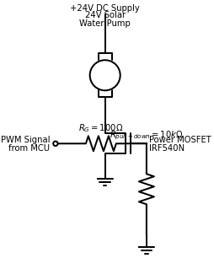
AEN 214: INTRODUCTION TO ELECTRONICS
Power MOSFET H-Bridge & BLDC Motor Inverters
• H-Bridge Architecture: Four MOSFETs arranged in an H-network allow bidirectional forward, reverse, and regenerative braking of DC motors.
• High-Side vs Low-Side Switches: Low-side N-channel MOSFETs have grounded sources; high-side MOSFETs have sources floating at motor voltage.
• High-Side Gate Bootstrapping: High-side N-channel MOSFET requires gate voltage V_gate = V_bus + 10V; achieved via bootstrap capacitor and diode.
• Three-Phase BLDC Inverter: Six power MOSFETs configured into three half-bridge legs drive 3-phase permanent magnet solar submersible pumps.
• Pulse Width Modulation (PWM): Microcontroller switches MOSFETs at 20 kHz, modulating duty cycle to achieve variable-speed water pumping.
Sokoine University of Agriculture | School of Engineering & Technology | Department of Agricultural Engineering
Slide 16 of 26

Slide 17
AEN 214: INTRODUCTION TO ELECTRONICS
Electrostatic Discharge (ESD) Protection Protocols
• The Dielectric Puncture Threat: SiO2 gate dielectric is only 5 to 50 nanometers thick; punctures permanently at V_GS > 20 V to 30 V.
• Human Body Model (HBM): A technician walking across a nylon carpet or dry African grain floor accumulates static potentials exceeding 15,000 V!
• Invisible Latent Damage: Minor ESD zap creates microscopic gate oxide pinholes; device passes bench test but fails prematurely in the field.
• Internal Protection Diodes: Many modern small-signal MOSFETs incorporate back-to-back Zener diodes across Gate and Source to clamp ESD.
• Field Handling Protocol: Wear grounded antistatic wrist straps; store MOSFETs in conductive black ESD foam; solder with grounded-tip irons.
Sokoine University of Agriculture | School of Engineering & Technology | Department of Agricultural Engineering
Slide 17 of 26

Slide 18
AEN 214: INTRODUCTION TO ELECTRONICS
Paralleling Power MOSFETs: The Positive Tempco Advantage
• The BJT Current Hogging Dilemma: BJTs have negative tempco (hotter transistor draws more current), causing thermal runaway when paralleled.
• MOSFET Self-Balancing Mechanism: Silicon mobility decreases with temperature, causing R_DS(on) to increase as temperature rises (+0.6%/°C).
• Current Sharing Dynamics: If MOSFET A runs hotter than MOSFET B -> R_DS(on) of A increases -> current automatically diverts into B!
• Direct Paralleling: Multiple power MOSFETs can be connected in parallel without external emitter ballasting resistors to handle hundreds of Amps.
• Individual Gate Resistors: Always provide a dedicated 10 Ohm to 47 Ohm series gate damping resistor for each parallel MOSFET to prevent parasitic HF ringing.
Sokoine University of Agriculture | School of Engineering & Technology | Department of Agricultural Engineering
Slide 18 of 26

Slide 19
AEN 214: INTRODUCTION TO ELECTRONICS
MOSFET Circuit Hardening for Rural Agriculture
• Gate Pulldown Resistors: Always place a 10 kOhm to 100 kOhm resistor directly between Gate and Source to ensure OFF state during MCU boot.
• Flyback Snubbers: Pair integral body diodes with external RC snubbers (10 Ohm + 4.7 nF) to suppress high-frequency inductive motor ringing.
• Overvoltage Clamping: Solder a bidirectional 18V Zener or TVS diode directly across Gate-Source pins on the PCB.
• Thermal Heatsinking: For motor currents exceeding 10A, mount MOSFETs to finned aluminum heatsinks with thermal silicone insulator pads.
• Tropical Humidity Ingress: Encapsulate high-voltage gate drive traces in conformal polyurethane coating to prevent ionic surface leakage.
Sokoine University of Agriculture | School of Engineering & Technology | Department of Agricultural Engineering
Slide 19 of 26

Slide 20
AEN 214: INTRODUCTION TO ELECTRONICS
Tanzanian Field Case Study 1: Solar Submersible Pump MOSFET Inverter Failure
FIELD LOCATION & PROBLEM IDENTIFICATION
• Geographic Location: Mbarali Paddy Rice Irrigation Scheme, Mbeya Region, Tanzania
A 7.5 kW solar photovoltaic submersible borehole pumping station suffered complete inverter blowouts every 4 to 6 weeks. Three half-bridge power MOSFET modules (IRFP260N) repeatedly suffered explosive drain-to-source punch-through, cutting off irrigation water to 40 hectares of rice paddies.
SUA ENGINEERING SOLUTION & AGRONOMIC IMPACT
SUA mechatronics engineers conducted DSO trace diagnostics and discovered two fatal design defects: (1) Inverter gate driver used standard 5V logic pulses that under-drove the 10V gates, causing excessive conduction heating, and (2) Long 80-meter submerged motor cables generated massive inductive voltage reflections (> 280V) that exceeded the 200V MOSFET breakdown rating.
Measurable Performance Metrics:
✔ Retrofitted with 500V, 0.075 Ohm CoolMOS power transistors with 12V high-current gate drivers.
✔ Installed dv/dt output line choke filters to suppress motor cable voltage reflections.
✔ Inverter operated 100% reliably throughout two entire 120-day paddy rice seasons.
Sokoine University of Agriculture | School of Engineering & Technology | Department of Agricultural Engineering
Slide 20 of 26

Slide 21
AEN 214: INTRODUCTION TO ELECTRONICS
Tanzanian Field Case Study 2: Precision PWM Variable-Rate Fertilizer Injection
FIELD LOCATION & PROBLEM IDENTIFICATION
• Geographic Location: Kilombero Valley Teak & Sugar Plantations, Morogoro, Tanzania
Tractor-mounted liquid fertilizer injection systems required high-speed variable-rate solenoid valve pulsing (100 Hz PWM) linked to tractor GPS forward velocity. The original mechanical relay switches failed within 3 days due to contact arcing, causing uneven fertilizer distribution and crop lodging.
SUA ENGINEERING SOLUTION & AGRONOMIC IMPACT
Engineers designed a solid-state PWM driver module using logic-level IRLB8721 power MOSFETs (R_DS(on) = 8.7 mOhm) controlled directly by an STM32 microcontroller. A fast ultra-fast recovery diode (MUR420) was placed across the 12V, 4A fertilizer solenoid valve to handle the 100 Hz inductive freewheeling current.
Measurable Performance Metrics:
✔ Achieved over 25 million valve switching cycles without a single electrical failure.
✔ Fertilizer application accuracy improved to within ±1.5% across varying tractor speeds.
✔ Reduced liquid fertilizer wastage by 18%, saving the estate over 22,000 USD annually.
Sokoine University of Agriculture | School of Engineering & Technology | Department of Agricultural Engineering
Slide 21 of 26

Slide 22
AEN 214: INTRODUCTION TO ELECTRONICS
Laboratory Bench Protocol: JFET Transfer Curves & Power MOSFET Switching Bench Protocol
PRACTICAL LAB LEARNING OUTCOMES & BENCH REQUIREMENTS:
• Measure N-channel JFET (2N5458) transfer characteristics and extract I_DSS and pinch-off V_P.
• Characterize JFET self-bias circuit and verify operating Q-point against theoretical equations.
• Demonstrate gate threshold voltage V_GS(th) and switching action of logic-level power MOSFET.
• Drive a DC motor with PWM signal and observe V_DS switching waveforms and body diode clamping on DSO.
STEP-BY-STEP PROTOTYPING & DIAGNOSTIC PROCEDURE:
Step 1: Wire 2N5458 JFET on breadboard; connect variable DC supply across Drain-Source (V_DS = 10V).
Step 2: Sweep gate voltage V_GS from 0V to -5V using second DC supply; record I_D; plot curve and extract I_DSS and V_P.
Step 3: Assemble self-bias circuit (R_D = 2.2k, R_S = 470, R_G = 1M); measure V_GSQ and V_DSQ with DMM; verify math.
Step 4: Mount IRLZ44N power MOSFET; connect 12V DC cooling fan as load; apply 0V then 3.3V to gate; record V_DS.
Step 5: Inject 10 kHz PWM signal from function generator into gate; connect DSO across drain; observe switching rise/fall times.
Sokoine University of Agriculture | School of Engineering & Technology | Department of Agricultural Engineering
Slide 22 of 26

Slide 23
AEN 214: INTRODUCTION TO ELECTRONICS
Diagnostic Troubleshooting of FET Circuits
• Floating Gate Latch-Up: A disconnected MOSFET gate acts as an antenna, floating to random voltages and oscillating; always tie with pulldown.
• Insufficient Gate Drive Voltage: Driving standard MOSFETs with 3.3V logic causes extreme conduction heating and thermal failure.
• Punctured Gate Dielectric: DMM resistance between Gate and Source reads < 100 kOhm (should be infinite); caused by ESD or inductive spike.
• Body Diode Reverse Recovery Ringing: Slow internal body diode in bridge inverters creates shoot-through currents; add external Schottky bypass.
• Parasitic Gate Oscillation: High-speed switching induces high-frequency VHF ringing on gate lead; cure by adding 22 Ohm series gate resistor.
Sokoine University of Agriculture | School of Engineering & Technology | Department of Agricultural Engineering
Slide 23 of 26

Slide 24
AEN 214: INTRODUCTION TO ELECTRONICS
Lecture 6 Self-Assessment & Upcoming Topics
SELF-ASSESSMENT & PROBLEM-SOLVING EXERCISES:
Q: Differentiate between a JFET and a MOSFET in terms of physical structure, input impedance, and gate conduction mechanism.
Q: State Shockley's equation for a JFET in saturation and explain the physical significance of parameters I_DSS and V_P.
Q: Explain why a power MOSFET has a positive temperature coefficient of ON-resistance, and why this allows safe direct paralleling.
Q: Why is it hazardous to drive a standard power MOSFET (e.g. IRF540N) directly from a 3.3V microcontroller GPIO pin?
Q: Explain the Miller effect in power MOSFET switching and describe why the gate voltage plateaus during turn-on.
NEXT LECTURE PREVIEW & REQUIRED PREPARATION:
Lecture 7 will explore Number Systems & Binary Arithmetic: Radix conversions, signed 2's complement, BCD, and tractor CAN-bus codes.
Sokoine University of Agriculture | School of Engineering & Technology | Department of Agricultural Engineering
Slide 24 of 26

Slide 25
AEN 214: INTRODUCTION TO ELECTRONICS
Lecture 6 Synthesis: Key Takeaways & Formula Sheet
CORE CONCEPTUAL TAKEAWAYS
✔ FETs are unipolar voltage-controlled devices with astronomical input impedance (> 10^12 Ohm).
✔ JFETs are normally-ON depletion devices; channel conduction is governed by Shockley's square-law equation.
✔ Power MOSFETs (HEXFETs) feature vertical trench structures with ultra-low ON-resistance (R_DS(on) < 10 mOhm).
✔ Logic-level MOSFETs (IRLZ series) are mandatory for direct 3.3V / 5V microcontroller switching.
✔ Thin SiO2 gate dielectrics are highly susceptible to ESD damage; strict static handling and gate TVS clamping are required.
CRITICAL ENGINEERING FORMULAS
★ JFET Shockley Equation: I_D = I_DSS · [ 1 - (V_GS / V_P) ]²
★ Maximum Transconductance: g_m0 = (2 · I_DSS) / |V_P|
★ Operating Transconductance: g_m = g_m0 · [ 1 - (V_GS / V_P) ]
★ JFET Self-Bias: V_GS = - I_D · R_S
★ E-MOSFET Saturation: I_D = k · [ V_GS - V_GS(th) ]²
★ MOSFET Conduction Loss: P_cond = I_D(rms)² · R_DS(on)
★ Peak Gate Current: I_gate(peak) = Q_G / t_sw
Sokoine University of Agriculture | School of Engineering & Technology | Department of Agricultural Engineering
Slide 25 of 26

Slide 26
AEN 214: INTRODUCTION TO ELECTRONICS
Prescribed References & Practical Laboratory Preparation
• Boylestad, R. L., & Nashelsky, L. (2018). Electronic Devices and Circuit Theory (11th ed.). Pearson Education.
• Sedra, A. S., & Smith, K. C. (2020). Microelectronic Circuits (8th ed.). Oxford University Press.
• Rashid, M. H. (2014). Power Electronics: Devices, Circuits, and Applications (4th ed.). Pearson.
• Laboratory Preparation: Review antistatic ESD handling procedures before attending Lab Session 6.
• Field Assignment: Complete Assignment 2, Questions 9 to 12 on JFET biasing and power MOSFET inverter design.
Sokoine University of Agriculture | School of Engineering & Technology | Department of Agricultural Engineering
Slide 26 of 26

